Slide 1
S2-19_DSECLZC415 Data Pre-processing
Slide Courtesy: Prof. T.V. Rao

Slide 2

The slides presented here are obtained from the authors of the books and from various other contributors. I hereby acknowledge all the contributors for their material and inputs.
I have added and modified a few slides to suit the requirements of the course.

Slide 3
Data Preprocessing Concepts

Slide 4
Preprocessing Objectives
To improve data quality
To modify data to better fit specific data mining technique

Slide 5
Major Tasks in Data Preprocessing
Data cleaning
Fill in missing values, smooth noisy data, identify or remove outliers, and resolve inconsistencies
Data integration
Integration of multiple databases, data cubes, or files
Data reduction
Dimensionality reduction
Numerosity reduction
Data compression
Data transformation and data discretization
Normalization
Concept hierarchy generation

Slide 6
Data Quality: Multidimensional View
Measures for data quality: A multidimensional view
Accuracy: correct or wrong, accurate or not
Completeness: not recorded, unavailable, …
Consistency: some modified but some not, dangling, …
Timeliness: timely update?
Believability: how trustable the data are correct?
Interpretability: how easily the data can be understood?

Slide 7
Data Quality
What kinds of data quality problems?
How can we detect problems with the data?
What can we do about these problems?
Examples of data quality problems:
Noise and outliers
missing values
duplicate data

Slide 8
Data Cleaning
Data in the Real World Is Dirty: Lots of potentially incorrect data, e.g., instrument faulty, human or computer error, transmission error
incomplete: lacking attribute values, lacking certain attributes of interest, or containing only aggregate data
e.g., Occupation = “ ” (missing data)
noisy: containing noise, errors, or outliers
e.g., Salary = “−10” (an error)
inconsistent: containing discrepancies in codes or names, e.g.,
Age = “42”, Birthday = “03/07/2010”
Was rating “1, 2, 3”, now rating “A, B, C”
discrepancy between duplicate records
Intentional (e.g., disguised missing data)
Jan. 1 as everyone’s birthday?

Slide 9
Incomplete (Missing) Data
Data is not always available
E.g., many tuples have no recorded value for several attributes, such as customer income in sales data
Missing data may be due to
equipment malfunction
inconsistent with other recorded data and thus deleted
data not entered due to misunderstanding
certain data may not be considered important at the time of entry
not register history or changes of the data
Missing data may need to be inferred

Slide 10
How to Handle Missing Data?
Ignore the tuple: usually done when class label is missing (when doing classification)—not effective when the % of missing values per attribute varies considerably
Fill in the missing value manually: tedious + infeasible?
Fill in it automatically with
a global constant : e.g., “unknown”, a new class?!
the attribute mean
the attribute mean for all samples belonging to the same class: smarter
the most probable value: inference-based such as Bayesian formula or decision tree

Slide 11
Noisy Data
Noise: random error or variance in a measured variable
Incorrect attribute values may be due to
faulty data collection instruments
data entry problems
data transmission problems
technology limitation
inconsistency in naming convention
Other data problems which require data cleaning
duplicate records
incomplete data
inconsistent data
Notes:
11

Slide 12
How to Handle Noisy Data?
Binning (also used for discretization)
first sort data and partition into (equal-frequency) bins
then one can smooth by bin means, smooth by bin median, smooth by bin boundaries, etc.
Binning methods smooth a sorted data value by consulting its "neighborhood," that is, the values around it, i.e. they perform local smoothing.
Regression
smooth by fitting the data into regression functions
Clustering
detect and remove outliers
Combined computer and human inspection
detect suspicious values and check by human (e.g., deal with possible outliers)
Notes:
Enrich using data integration research!!

Slide 13
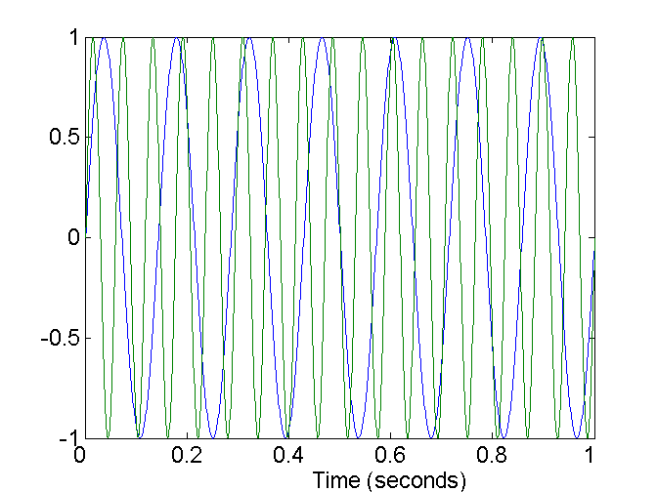
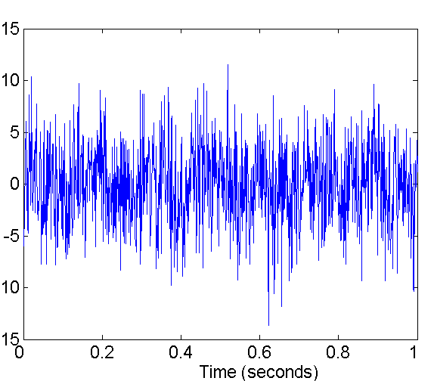
Noise
Noise refers to modification of original values
Examples: distortion of a person’s voice when talking on a poor phone and “snow” on television screen
Two Sine Waves
Two Sine Waves + Noise

Slide 14
Duplicate Data
Data set may include data objects that are duplicates, or almost duplicates of one another
Major issue when merging data from heterogenous sources
Examples:
Same person with multiple email addresses
Data cleaning
Process of dealing with duplicate data issues

Slide 15
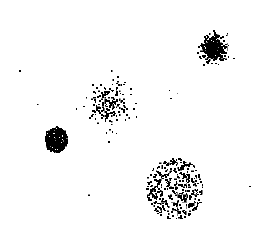
Outliers
Outliers are data objects with characteristics that are considerably different than most of the other data objects in the data set

Slide 16
Data Cleaning as a Process
Data discrepancy detection
Use metadata (e.g., domain, range, dependency, distribution)
Check field overloading
Check uniqueness rule, consecutive rule and null rule
Use commercial tools
Data scrubbing: use simple domain knowledge (e.g., postal code, spell-check) to detect errors and make corrections
Data auditing: by analyzing data to discover rules and relationship to detect violators (e.g., correlation and clustering to find outliers)
Data migration and integration
Data migration tools: allow transformations to be specified
ETL (Extraction/Transformation/Loading) tools: allow users to specify transformations through a graphical user interface
Integration of the two processes
Iterative and interactive (e.g., Potter’s Wheels)

Slide 17
Data Preprocessing Techniques

Slide 18
Major Tasks in Data Preprocessing
Data cleaning
Fill in missing values, smooth noisy data, identify or remove outliers, and resolve inconsistencies
Data integration
Integration of multiple databases, data cubes, or files
Data reduction
Dimensionality reduction
Numerosity reduction
Data compression
Data transformation and data discretization
Normalization
Concept hierarchy generation

Slide 19
Data Integration
Data integration:
Combines data from multiple sources into a coherent store
Schema integration: e.g., A.cust-id ≡ B.cust-#
Integrate metadata from different sources
Entity identification problem:
Identify real world entities from multiple data sources, e.g., Bill Clinton = William Clinton
Detecting and resolving data value conflicts
For the same real world entity, attribute values from different sources are different
Possible reasons: different representations, different scales, e.g., metric vs. British units

Slide 20
Any problems with the Data?
Name | Age | DateOfFirstBuy | Profession | DateOfBirth
Bill Gates | 34 | 15-Jan-2015 | MGR | Feb 24, 1981
John | 33 | 27-Jan-2015 |  | Mar 27, 1982
William Gates | 34 | 15-Jan-2015 | MGR | Feb 24, 1981
Kennedy | 32 | 30-Jan-2015 | DOC | Nov 25,1982

Slide 21
Any problems with the Data?
Name | Age | DateOfFirstBuy | Profession | DateOfBirth
Bill Gates | 34 | 15-Jan-2015 | MGR | Feb 24, 1981
John | 33 | 27-Jan-2015 |  | Mar 27, 1982
William Gates | 34 | 15-Jan-2015 | MGR | Feb 24, 1981
Kennedy | 32 | 30-Jan-2015 | DOC | Nov 25,1982
Missing values in Profession column
Format of DateOfFirstBuy and DateOfBirth are different, needs standardization
Row 1 and Row 3 are potentially duplicate data.
Both Age and DateOfBirth are stored. Age is derived attribute.
Inconsistent format for name, missing first or last names
Entity identification issues

Slide 22
Handling Redundancy in Data Integration
Redundant data occur often when integration of multiple databases
Object identification: The same attribute or object may have different names in different databases
Derivable data: One attribute may be a “derived” attribute in another table, e.g., annual revenue
Redundant attributes may be able to be detected by correlation analysis and covariance analysis
Careful integration of the data from multiple sources may help reduce/avoid redundancies and inconsistencies and improve mining speed and quality

Slide 23
Correlation Analysis (Nominal Data)
Χ² (chi-square) test
The larger the Χ² value, the more likely the variables are related
The cells that contribute the most to the Χ² value are those whose actual count is very different from the expected count
Correlation does not imply causality
# of hospitals and # of car-theft in a city are correlated
Both are causally linked to the third variable: population

Slide 24
Chi-Square Calculation: An Example
Χ² (chi-square) calculation (numbers in parenthesis are expected counts calculated based on the data distribution in the two categories)
It shows that like_science_fiction and play_chess are correlated in the group
 | Play chess | Not play chess | Sum (row)
Like science fiction | 250(90) | 200(360) | 450
Not like science fiction | 50(210) | 1000(840) | 1050
Sum(col.) | 300 | 1200 | 1500

Slide 25
Correlation Analysis (Numeric Data)
Correlation coefficient (also called Pearson’s product moment coefficient)
where n is the number of tuples, and are the respective means of A and B, σ_{A} and σ_{B} are the respective standard deviation of A and B, and Σ(a_{i}b_{i}) is the sum of the AB cross-product.
If r_{A,B} > 0, A and B are positively correlated (A’s values increase as B’s). The higher, the stronger correlation.
r_{A,B} = 0: independent; r_{AB} < 0: negatively correlated

Slide 26
Correlation (viewed as linear relationship)
Correlation measures the linear relationship between objects
To compute correlation, we standardize data objects, A and B, and then take their dot product

Slide 27
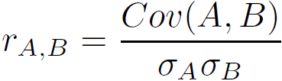
Covariance (Numeric Data)
Covariance is similar to correlation
where n is the number of tuples, and are the respective mean or expected values of A and B, σ_{A} and σ_{B} are the respective standard deviation of A and B
Positive covariance: If Cov_{A,B} > 0, then A and B both tend to be larger than their expected values
Negative covariance: If Cov_{A,B} < 0 then if A is larger than its expected value, B is likely to be smaller than its expected value
Independence: Cov_{A,B} = 0
Correlation coefficient:

Slide 28

Co-Variance: An Example
It can be simplified in computation as
Suppose two stocks A and B have the following values in one week: (2, 5), (3, 8), (5, 10), (4, 11), (6, 14).
Question: If the stocks are affected by the same industry trends, will their prices rise or fall together?
E(A) = (2 + 3 + 5 + 4 + 6)/ 5 = 20/5 = 4
E(B) = (5 + 8 + 10 + 11 + 14) /5 = 48/5 = 9.6
Cov(A,B) = (2×5+3×8+5×10+4×11+6×14)/5 − 4 × 9.6 = 4
Thus, A and B rise together since Cov(A, B) > 0.

Slide 29
Discretization
Three types of attributes
Nominal—values from an unordered set, e.g., color, profession
Ordinal—values from an ordered set, e.g., military or academic rank
Numeric—real numbers, e.g., integer or real numbers
Discretization: Divide the range of a continuous attribute into intervals
Interval labels can then be used to replace actual data values
Reduce data size by discretization
Supervised vs. unsupervised
Split (top-down) vs. merge (bottom-up)
Discretization can be performed recursively on an attribute
Prepare for further analysis, e.g., classification
Notes:
08.09.12 MK: Slide moved here from Ch. 3. Added examples.

Slide 30
Data Discretization Methods
Typical methods: All the methods can be applied recursively
Binning
Top-down split, unsupervised
Histogram analysis
Top-down split, unsupervised
Clustering analysis (unsupervised, top-down split or bottom-up merge)
Decision-tree analysis (supervised, top-down split)
Correlation (e.g., χ²) analysis (unsupervised, bottom-up merge)
30
Notes:
30

Slide 31
Simple Discretization: Binning
Equal-width (distance) partitioning
Divides the range into N intervals of equal size: uniform grid
if A and B are the lowest and highest values of the attribute, the width of intervals will be: W = (B –A)/N.
The most straightforward, but outliers may dominate presentation
Skewed data is not handled well
Equal-depth (frequency) partitioning
Divides the range into N intervals, each containing approximately same number of samples
Good data scaling
Managing categorical attributes can be tricky

Slide 32
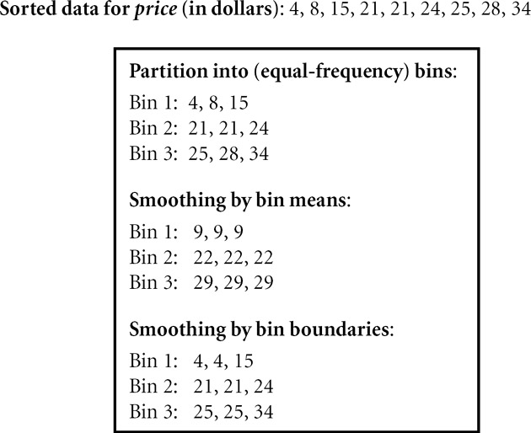
Binning Methods for Data Smoothing

Slide 33
Discretization by Classification & Correlation Analysis
Classification (e.g., decision tree analysis)
Supervised: Given class labels, e.g., cancerous vs. benign
Using entropy to determine split point (discretization point)
Top-down, recursive split
Details to be covered in Chapter “Classification”
Correlation analysis (e.g., Chi-merge: χ²-based discretization)
Supervised: use class information
Bottom-up merge: find the best neighboring intervals (those having similar distributions of classes, i.e., low χ² values) to merge
Merge performed recursively, until a predefined stopping condition
33
Notes:
33

Slide 34
Data Reduction Strategies
Data reduction: Obtain a reduced representation of the data set that is much smaller in volume but yet produces the same (or almost the same) analytical results
Why data reduction? — A database/data warehouse may store terabytes of data. Complex data analysis may take a very long time to run on the complete data set.
Data reduction strategies
Dimensionality reduction, e.g., remove unimportant attributes
Wavelet transforms
Principal Components Analysis (PCA)
Feature subset selection, feature creation
Numerosity reduction (some simply call it: Data Reduction)
Regression and Log-Linear Models
Histograms, clustering, sampling
Data cube aggregation
Data compression

Slide 35
Data Reduction : Dimensionality Reduction
Curse of dimensionality
When dimensionality increases, data becomes increasingly sparse
Density and distance between points, which is critical to clustering, outlier analysis, becomes less meaningful
The possible combinations of subspaces will grow exponentially
Dimensionality reduction
Avoid the curse of dimensionality
Help eliminate irrelevant features and reduce noise
Reduce time and space required in data mining
Allow easier visualization
Dimensionality reduction techniques
Wavelet transforms
Principal Component Analysis
Supervised and nonlinear techniques (e.g., feature selection)
Notes:
35

Slide 36
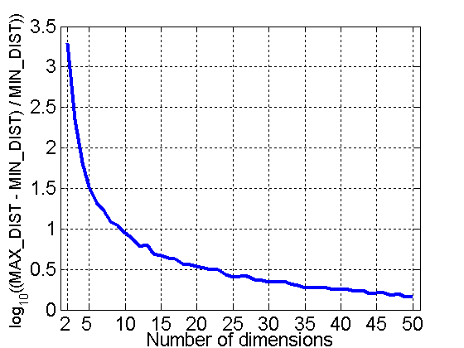
Curse of Dimensionality
When dimensionality increases, data becomes increasingly sparse in the space that it occupies
Definitions of density and distance between points, which are critical for clustering and outlier detection, become less meaningful
When dimensionality increases, data becomes increasingly sparse in the space that it occupies
Definitions of density and distance between points, which are critical for clustering and outlier detection, become less meaningful
Randomly generate 500 points
Compute difference between max and min distance between any pair of points

Slide 37


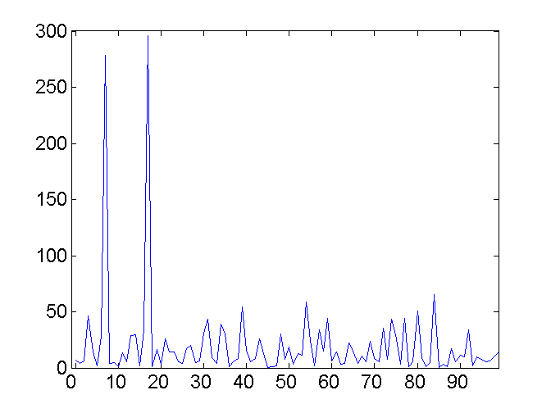
Mapping Data to a New Space
Fourier transform
Wavelet transform
Two Sine Waves
Two Sine Waves + Noise
Frequency
Notes:
37

Slide 38
Wavelet Transformation
Discrete wavelet transform (DWT) for linear signal processing, multi-resolution analysis
Compressed approximation: store only a small fraction of the strongest of the wavelet coefficients
Similar to discrete Fourier transform (DFT), but better lossy compression, localized in space
Method:
Length, L, must be an integer power of 2 (padding with 0’s, when necessary)
Each transform has 2 functions: smoothing, difference
Applies to pairs of data, resulting in two set of data of length L/2
Applies two functions recursively, until reaches the desired length
Notes:
38

Slide 39
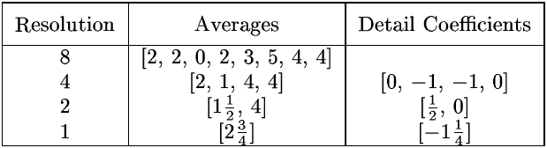
Wavelet Decomposition
Wavelets: A math tool for space-efficient hierarchical decomposition of functions
S = [2, 2, 0, 2, 3, 5, 4, 4] can be transformed to S^ = [2³/₄, -1¹/₄, ¹/₂, 0, 0, -1, -1, 0]
Compression: many small detail coefficients can be replaced by 0’s, and only the significant coefficients are retained
Notes:
39

Slide 40
Principal Component Analysis (PCA)
Find a projection that captures the largest amount of variation in data
The original data are projected onto a much smaller space, resulting in dimensionality reduction.
x₂
e
x₁

Slide 41
Principal Component Analysis (Steps)
Given N data vectors from n-dimensions, find k ≤ n orthogonal vectors (principal components) that can be best used to represent data
Normalize input data: Each attribute falls within the same range
Compute k orthonormal (unit) vectors, i.e., principal components
Each input data (vector) is a linear combination of the k principal component vectors
The principal components are sorted in order of decreasing “significance” or strength
Since the components are sorted, the size of the data can be reduced by eliminating the weak components, i.e., those with low variance (i.e., using the strongest principal components, it is possible to reconstruct a good approximation of the original data)
Works for numeric data only

Slide 42
Attribute Subset Selection
Another way to reduce dimensionality of data
Redundant attributes
Duplicate much or all of the information contained in one or more other attributes
E.g., purchase price of a product and the amount of sales tax paid
Irrelevant attributes
Contain no information that is useful for the data mining task at hand
E.g., students' ID is often irrelevant to the task of predicting students' GPA

Slide 43
Heuristic Search in Attribute Selection
There are 2^{d} possible attribute combinations of d attributes
Typical heuristic attribute selection methods:
Best single attribute under the attribute independence assumption: choose by significance tests
Best step-wise feature selection:
The best single-attribute is picked first
Then next best attribute condition to the first, ...
Step-wise attribute elimination:
Repeatedly eliminate the worst attribute
Best combined attribute selection and elimination
Optimal branch and bound:
Use attribute elimination and backtracking

Slide 44
Attribute Creation (Feature Generation)
Create new attributes (features) that can capture the important information in a data set more effectively than the original ones
Three general methodologies
Attribute extraction
Domain-specific
Mapping data to new space (see: data reduction)
E.g., Fourier transformation, wavelet transformation
Attribute construction
Combining features
Data discretization
Notes:
44

Slide 45
Data Reduction: Numerosity Reduction
Reduce data volume by choosing alternative, smaller forms of data representation
Parametric methods (e.g., regression)
Assume the data fits some model, estimate model parameters, store only the parameters, and discard the data (except possible outliers)
Ex.: Log-linear models—obtain value at a point in m-D space as the product on appropriate marginal subspaces
Non-parametric methods
Do not assume models
Major families: histograms, clustering, sampling, …

Slide 46
Text Books
 | Author(s), Title, Edition, Publishing House
T1 | Tan P. N., Steinbach M & Kumar V. “Introduction to Data Mining” Pearson Education
T2 | Data Mining: Concepts and Techniques, Third Edition by Jiawei Han, Micheline Kamber and Jian Pei Morgan Kaufmann Publishers
R1 | Predictive Analytics and Data Mining: Concepts and Practice with RapidMiner by Vijay Kotu and Bala Deshpande Morgan Kaufmann Publishers

Slide 47
Thank You

